Slide 1
Apoptosis Boolean Network
Amnon Bleich, Agnieszka Krawczyk,
Mathias Wajnberg

Slide 2
What are we going to talk about today?
Apoptosis - introduction, caspase cascade and inhibitors
Results:
  Basic network model
  Analysis of the network: attractors
  Analysis of the robustness
  IAP
  BCL-2
Conclusions

Slide 3
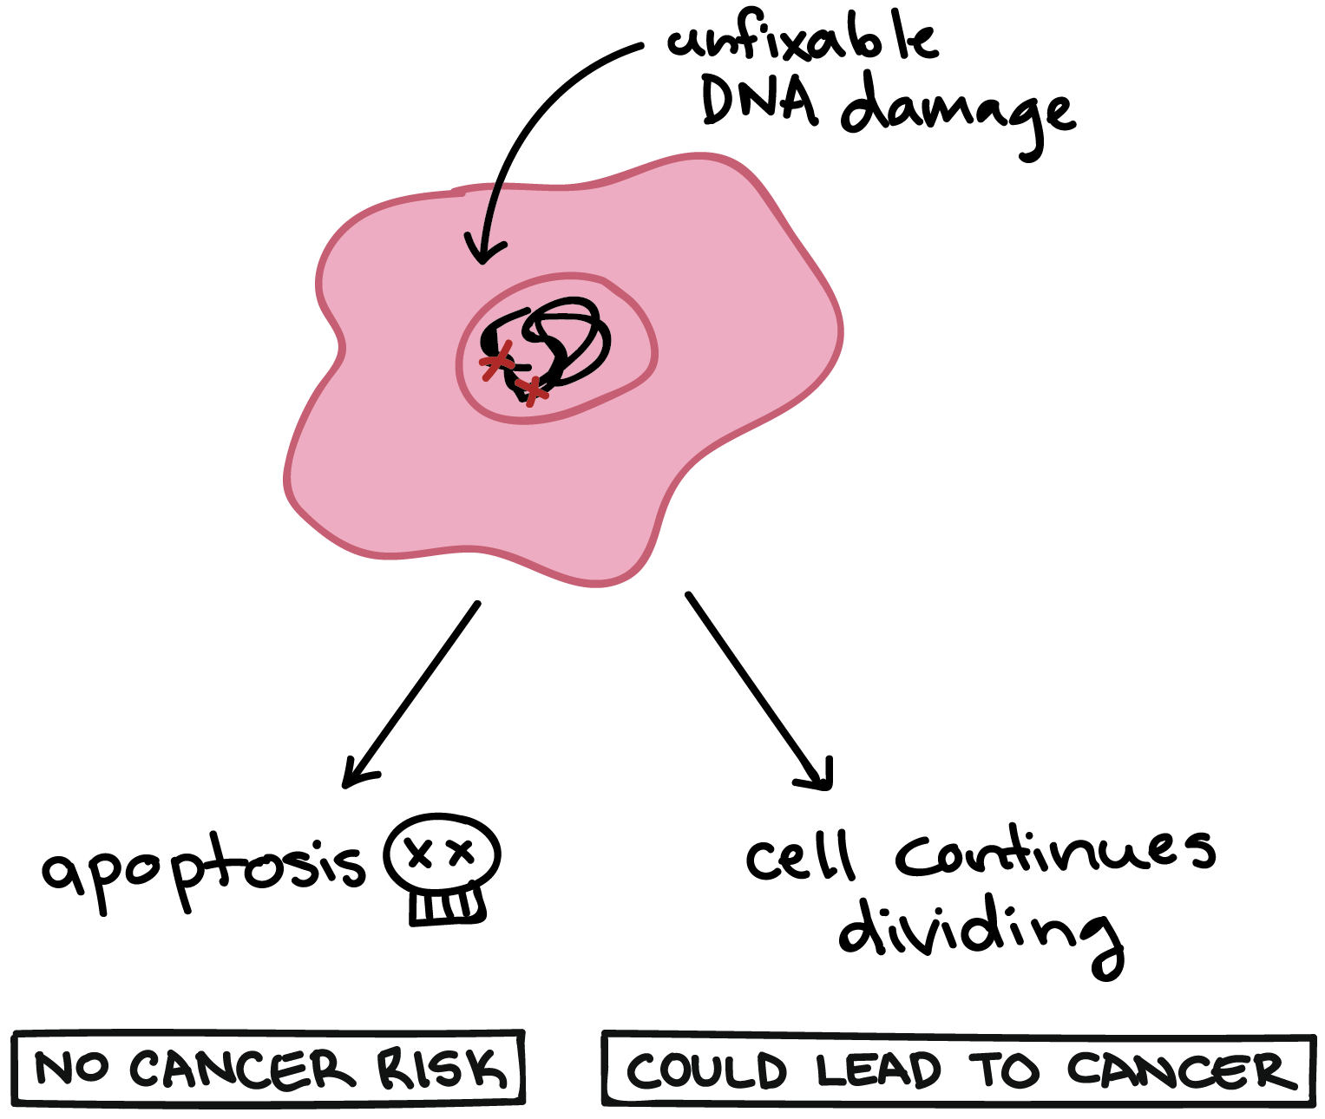
Introduction & biological background

Slide 4
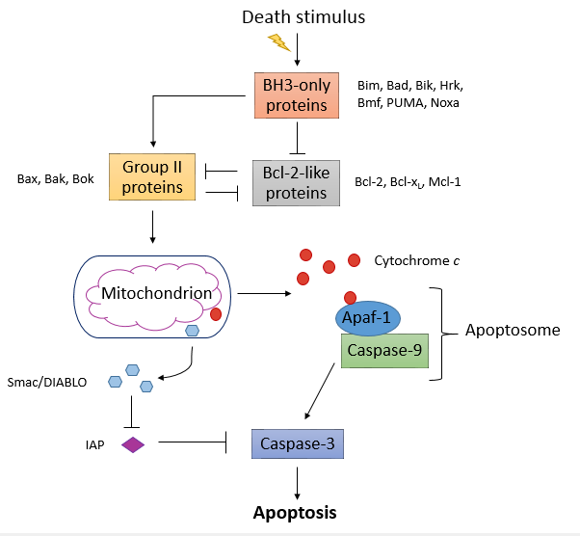
Apoptosis pathway
In our network model we focused on two possible steps where apoptosis could be suppressed:
Bcl-2 protein family
IAP (Inhibitors of apoptosis proteins)
Source: http://www.cubocube.com

Slide 5
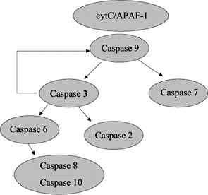
Caspase cascade
Activation of caspases leads to degradation of cellular components for apoptosis.
Caspase deficiency has been identified as a cause of tumour development.

Slide 6
BCL-2 family
Family | Group | Membres
BCL-2 | Anti-apoptotic | Bcl-2, Bcl-xL, McL-1, Bcl-W
 | Pro-apoptotic | Bax, Bak
most well known of the anti-apoptotic members
classified as an oncogene
may inhibit apoptosis in two ways; either by directly controlling the activation of caspases, or by disrupting the channels that allow proapoptotic factors from leaving the mitochondria

Slide 7
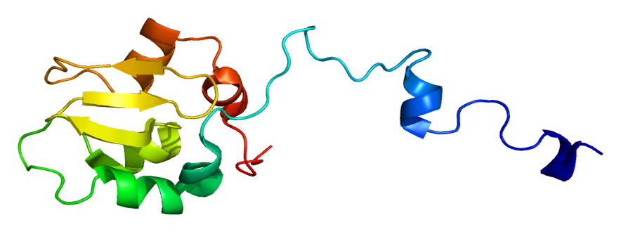
IAP
The best characterized - XIAP, which binds caspase-9, caspase-3 and caspase-7, thereby inhibiting their activation and preventing apoptosis.
Deregulation of XIAP can result in “cancer, neurodegenerative disorders, and autoimmunity”.
High proportions of XIAP -> tumor marker.
Based on PyMOL

Slide 8
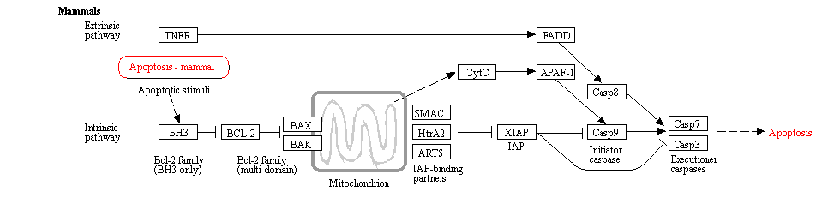
Results:
Notes:
Kegg pathway to compare with our model

Slide 9
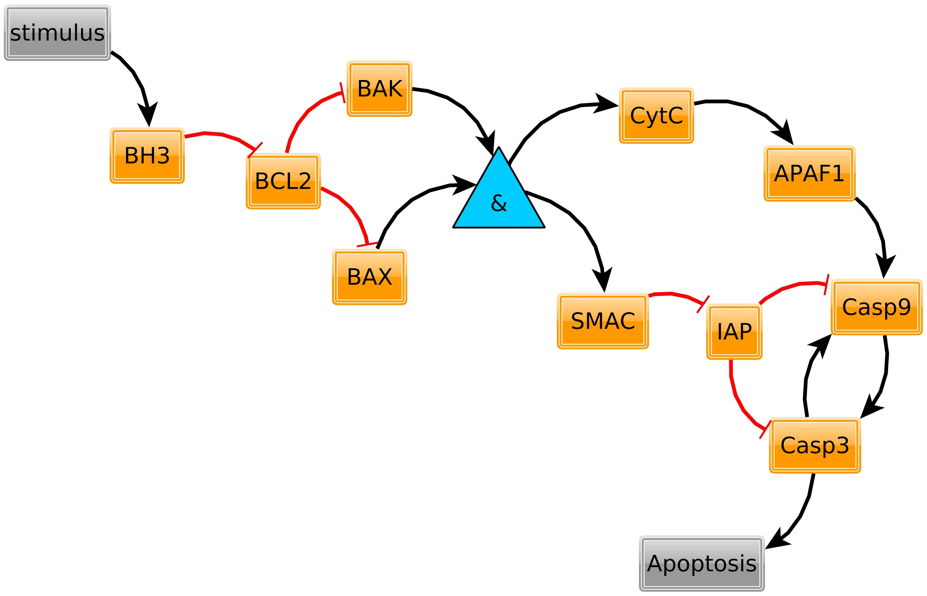
Our basic network from Boolnet
Notes:
add - SMAC activated by BAK&BAX, and inhibits IAP (therefore promotes apoptosis)

Slide 10
Our basic network from Boolnet
OR function implicit
existence of caspase feedback is controversial in papers
Notes:
add - SMAC activated by BAK&BAX, and inhibits IAP (therefore promotes apoptosis)

Slide 11
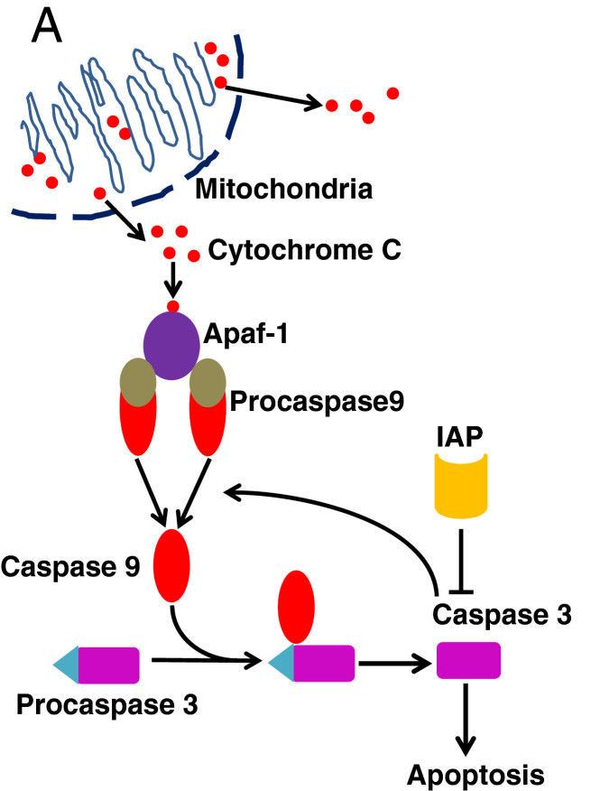


Slide 12
Analysis of the Boolean Network

Slide 13
Attractors

Slide 14
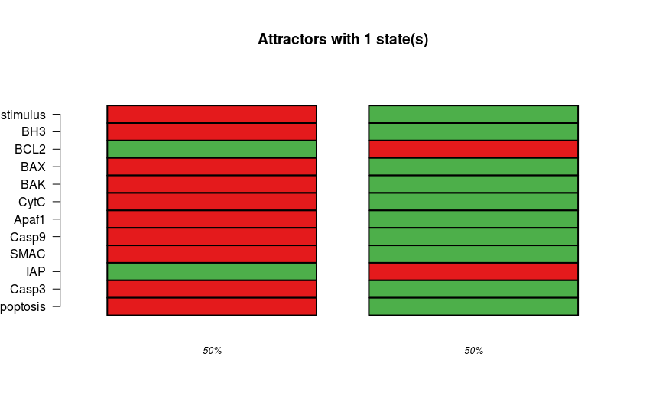
All Attractors W.T - Stimulus controls outcome

Slide 15
Robustness w.o/w feedback
> robust_no_feedback_att = perturbTrajectories(intrinsic,
+ measure = "attractor",
+ numSamples = 1000,
+ flipBits = 1)
>
> robust_no_feedback_ham = perturbTrajectories(intrinsic,
+ measure = "hamming",
+ numSamples = 1000,
+ flipBits = 1,
+ updateType ="asynchronous")
>
> robust_feedback_att = perturbTrajectories(intrinsic_feedback,
+ measure = "attractor",
+ numSamples = 1000,
+ flipBits = 1)
>
> robust_feedback_ham = perturbTrajectories(intrinsic_feedback,
+ measure = "hamming",
+ numSamples = 1000,
+ flipBits = 1,
+ updateType ="asynchronous")
> ## comparable robustness
> print(robust_no_feedback_att$value)
[1] 0.923
> print(robust_no_feedback_ham$value)
[1] 0.1433333
> print(robust_feedback_att$value) # ~724
[1] 0.929
> print(robust_feedback_ham$value) # ~724
[1] 0.1408333
Notes:
If measure="attractor", the attractors of all initial states and all perturbed states are identified. The statistic is a logical vector specifying whether the attractors are identical in each pair of initial state and perturbed initial state.
If measure="hamming", the normalized Hamming distances between the successor states of each initial state and the corresponding perturbed state are calculated.

Slide 16
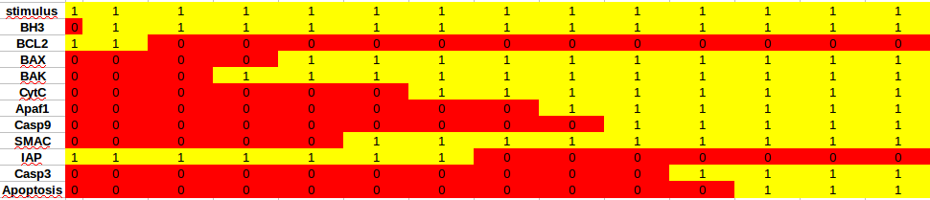
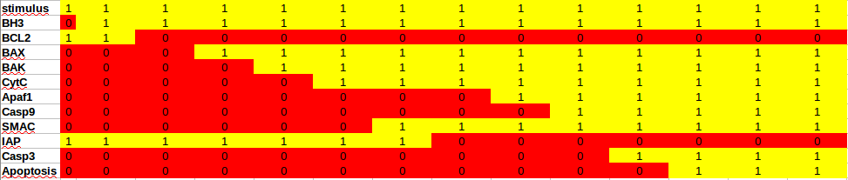
Asynchronous attractor paths

Slide 17
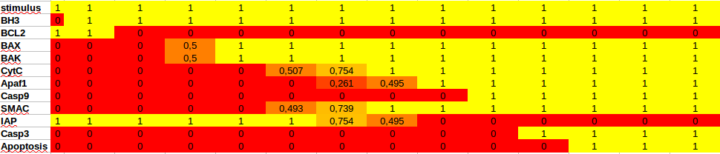
Asynchronous attractor path - average of 4000 runs

Slide 18
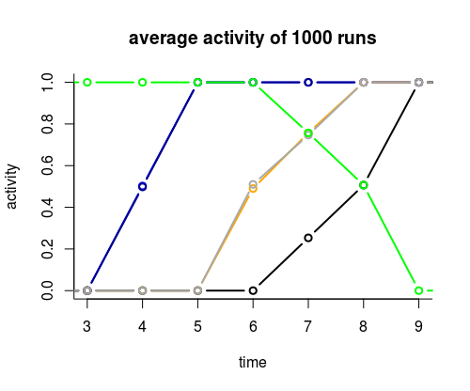
Asynchronous attractor path - average of 4000 runs
BAX
BAK
CytC
Apaf1
SMAC
IAP

Slide 19
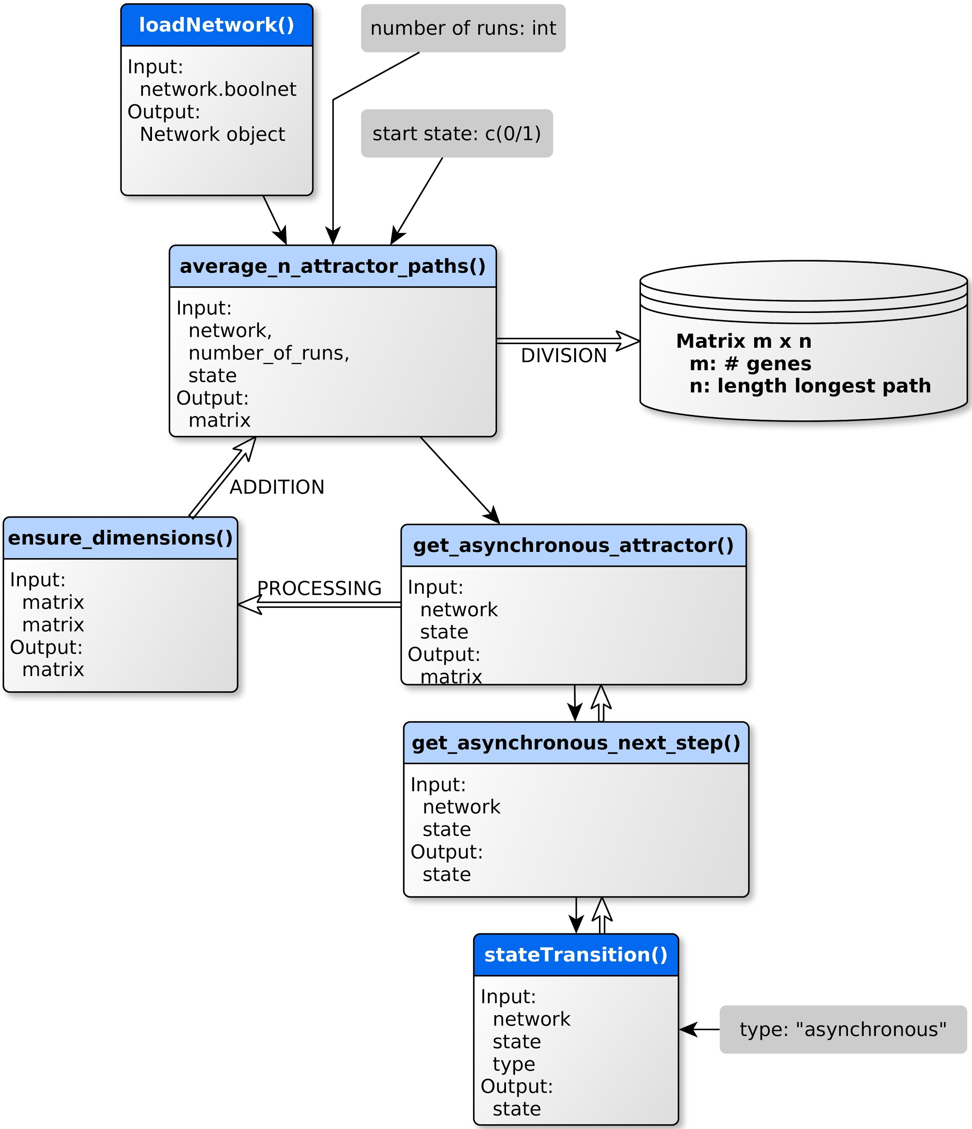
Asynchronous attractor path
while ((identical(previous_state, next_state))
&& (j < length(network$genes)*500 ) ){
previous_state <- next_state
next_state <- stateTransition(network = network,
state = previous_state,
type = "asynchronous")
j= j+1
}
return(next_state)

Slide 20
Asynchronous attractor path
while(!identical(previous_step, next_step)){
previous_step <- next_step
next_step <- get_asynchronous_next_step(network,
previous_step)
steps_matrix <- cbind(steps_matrix, next_step)
i = i +1
}

Slide 21
Our basic network from Boolnet

Slide 22
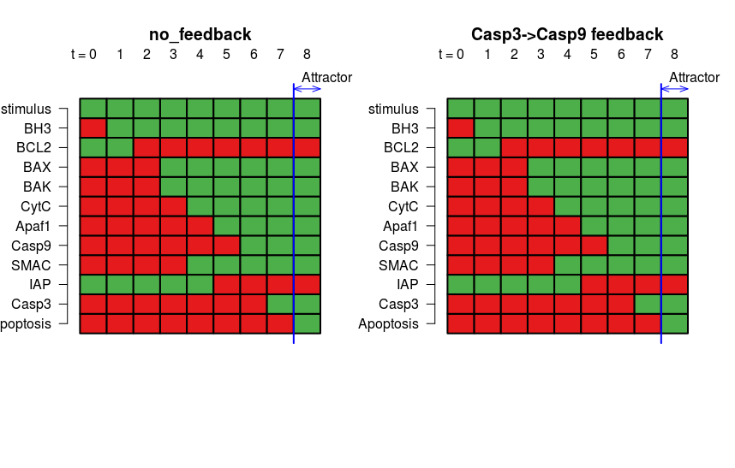
W.T - Casp3-9 feedback
start state for simulation of loss of stimulus
invert stimulus
Caspase 3- Caspase 9 feedback is not relevant when there is a constant stimulus (the “normal” mechanism).

Slide 23
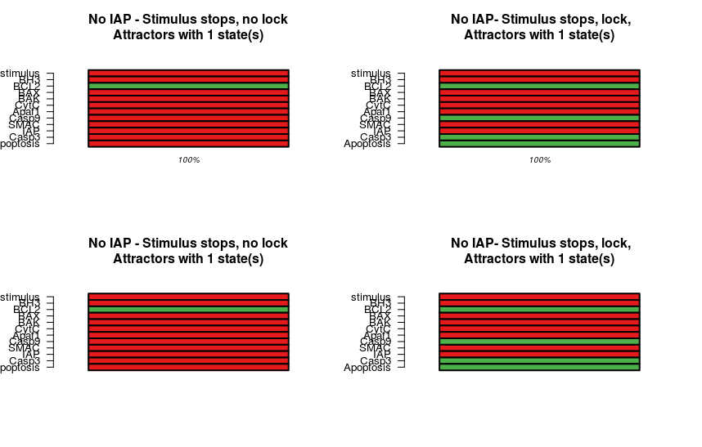
Stimulus stops - No IAP, lock is active
Synchronous
Asynchronous

Slide 24
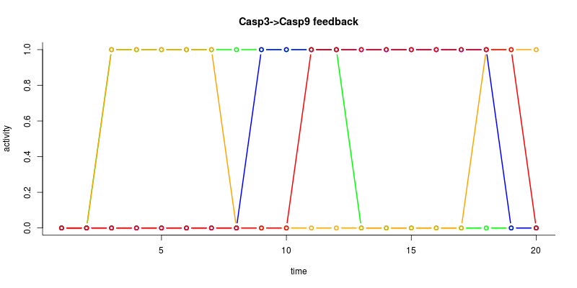
Synchronous simulation: Stimulus stops - IAP unlocks apoptotic state
stimulus
IAP
Casp9
Apoptosis
Stimulus stops
IAP becomes active if stimulus stops → Apoptosis inhibited

Slide 25
Observation 1
Casp. 3 - Casp. 9 positive feedback:
makes apoptosis more robust
gives significance to the IAP protein
  we believe there is logical ground to its existence

Slide 26
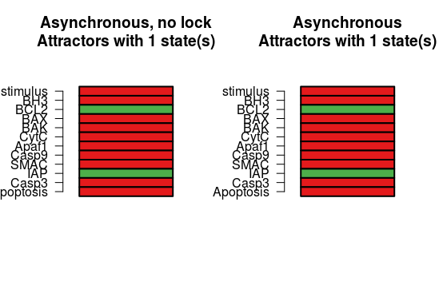
Asynchronous - Stimulus stops - IAP unlocks
IAP ‘unlocks’ the casp. feedback - once stimulus stops, apoptosis stops.
System behaves as the non-feedback one

Slide 27
Perturbation

Slide 28
Observation 2:
When IAP is off, the lock takes place, meaning loss of stimulus doesn’t stop apoptosis

Slide 29
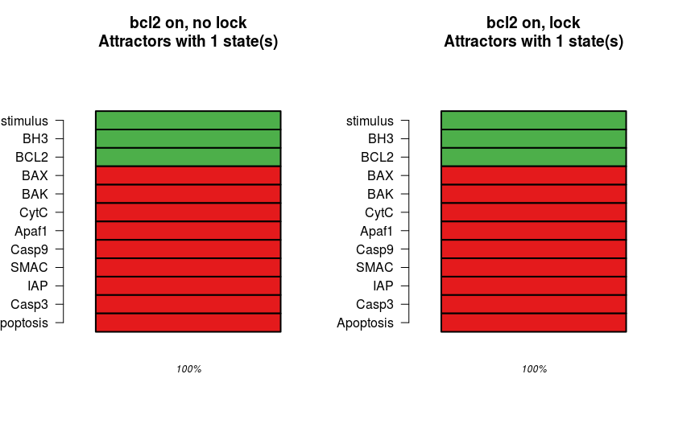
BCL2 Forced on - Blocks Apoptosis

Slide 30
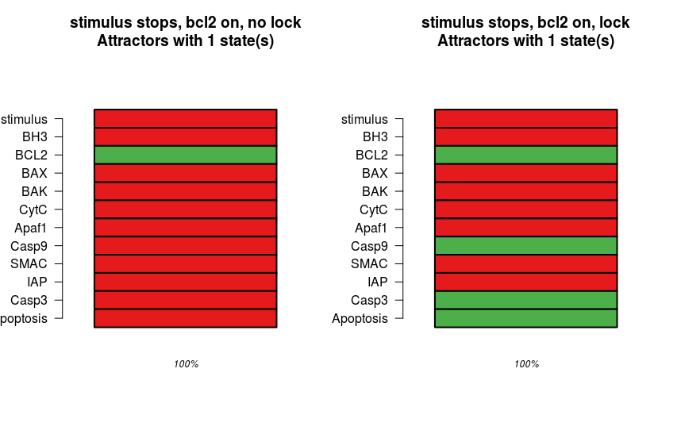
BCL2 Forced on Stimulus stops - lock

Slide 31
Observation 3:
BCL2 stops apoptosis upstream (saves energy) but doesn’t unlock in case stimulus stops in the middle

Slide 32
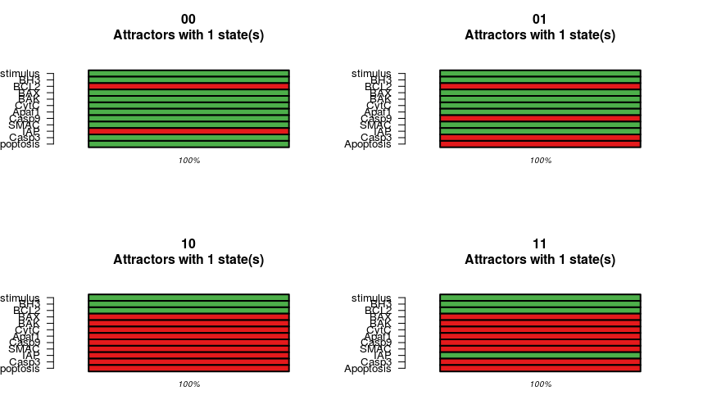
BCL2/IAP forced ON/OFF - Normal case
asynchronous runs

Slide 33
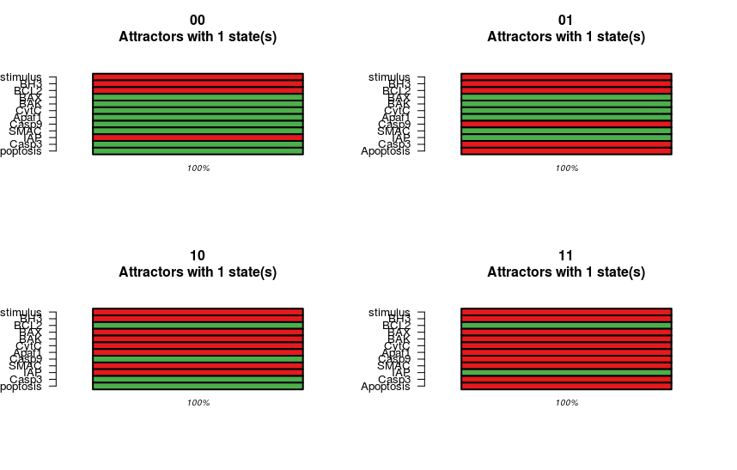
BCL2/IAP forced ON/OFF - Stimulus Stops

Slide 34
Summary of results
Stimulus constantly on |  | Bcl2 off | Bcl2 on
 | IAP off | Apoptosis on | Apoptosis off early
 | IAP on | Apoptosis off late | Apoptosis off early
Stimulus stops |  | Bcl2 off | Bcl2 on
 | IAP off | Appoptosis continues (lock) | Apoptosis on (lock)
 | IAP on | Apoptosis off (unlock) | Apoptosis off (unlock)

Slide 35
Summary of results
Stimulus constantly on |  | Bcl2 off | Bcl2 on
 | IAP off | Apoptosis on | Apoptosis off early
 | IAP on | Apoptosis off late | Apoptosis off early
Stimulus stops |  | Bcl2 off | Bcl2 on
 | IAP off | Appoptosis continues (lock) | Apoptosis on (lock)
 | IAP on | Apoptosis off (unlock) | Apoptosis off (unlock)
BCL2 more important

Slide 36
Summary of results
Stimulus constantly on |  | Bcl2 off | Bcl2 on
 | IAP off | Apoptosis on | Apoptosis off early
 | IAP on | Apoptosis off late | Apoptosis off early
Stimulus stops |  | Bcl2 off | Bcl2 on
 | IAP off | Appoptosis continues (lock) | Apoptosis on (lock)
 | IAP on | Apoptosis off (unlock) | Apoptosis off (unlock)
BCL2 more important
IAP more important

Slide 37
Main Conclusions
Conclusions after studying the network
  Casp 3-9 positive feedback supports finishing of the apoptosis once it started
  IAP inhibits apoptosis even when apoptosis already started (inhibited during apoptosis but if stimulus stops it’s re-activated)
Behaviour of system correctly modelled in BoolNet
  according to taxonomy / KEGG graph
  simulation outcomes support well-known features of the pathway

Slide 38
Further research -
IAP’s in w.t - is it always there?
Yes - further investigation regarding casp 3-9 positive feedback as well as IAP’s role are needed (robustness doesn’t differ ~0.085 average hamming)
No - conditions for rise/decline in IAP
Does Casp. 3 - Casp. 9 positive feedback loop indeed exists?
Look for more scenarios in which this ‘lock’ plays a role
  Amplification of casp 9- design ODE model with sigmoid increase for apoptosis activation

Slide 39
Experiment design
BCL2 as energy consumption reducer -
In case IAP is off, under the hypothesis that BCL 2 inhibits most of the proteins in the system, would it be worthwhile for BCL 2 to be turned on, seeing that apoptosis won’t be disturbed thanks to Casp 3-9 lock

Slide 40
Thank you for your attention!
Questions?

